Slide 1
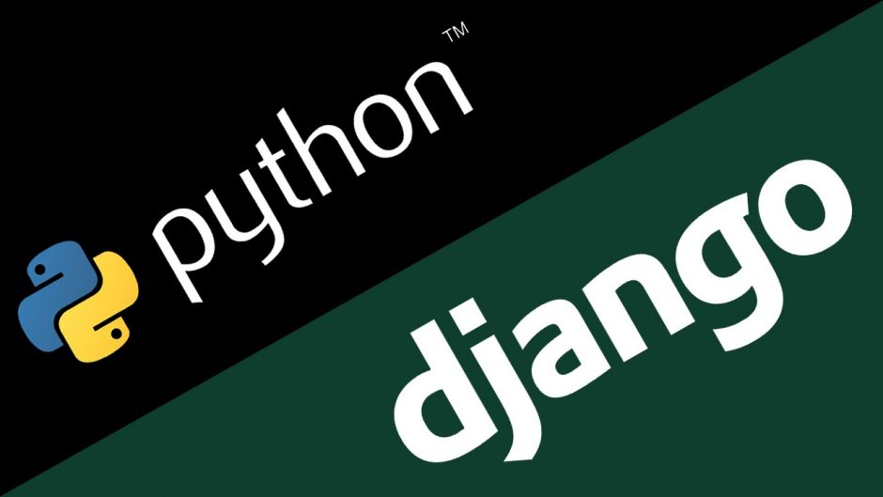

Deploying a Python Web App on Docker Container
Submitted By:-
Sahil Srivastava
Shruti Sharma

Slide 2
Table of Contents
Python Web App
Highlights of the App
Command to create a project in django
Necessary files in a django web app
Blog Admin page
Command to Create a super user
Database and Migrations
Commands of database execution

Slide 3
Zero Level DFD of BLOG
First Level DFD of BLOG
Second Level DFD of BLOG
Entity Relationship
Description of Database
ER DIAGRAM
USE CASE Diagram
Sequence Diagram
Blog Home Page

Slide 4
Blog Login Page
Blog Registration Page
Introduction to Docker
What is a Container?
Key Benefits of Docker Container
Docker Basics
Comparing Containers and VM's
Deploying a python web app on docker container

Slide 5

Python Web App
This web app is a blogging website named BLOG which is built using:-
Django
HTML
CSS
BootStrap

Slide 6
Highlights of the App
The web app is a blogging website where different users can like different posts or twitter posts.
The web app contains an authentication system where a user or an admin can log in using his/her credentials and log out.
The web app also contains a registration system where a new new user can register on the website.
The login has a forgot password link where a user can reset his/her password by using his email.
The users have also the ability to delete post.

Slide 7
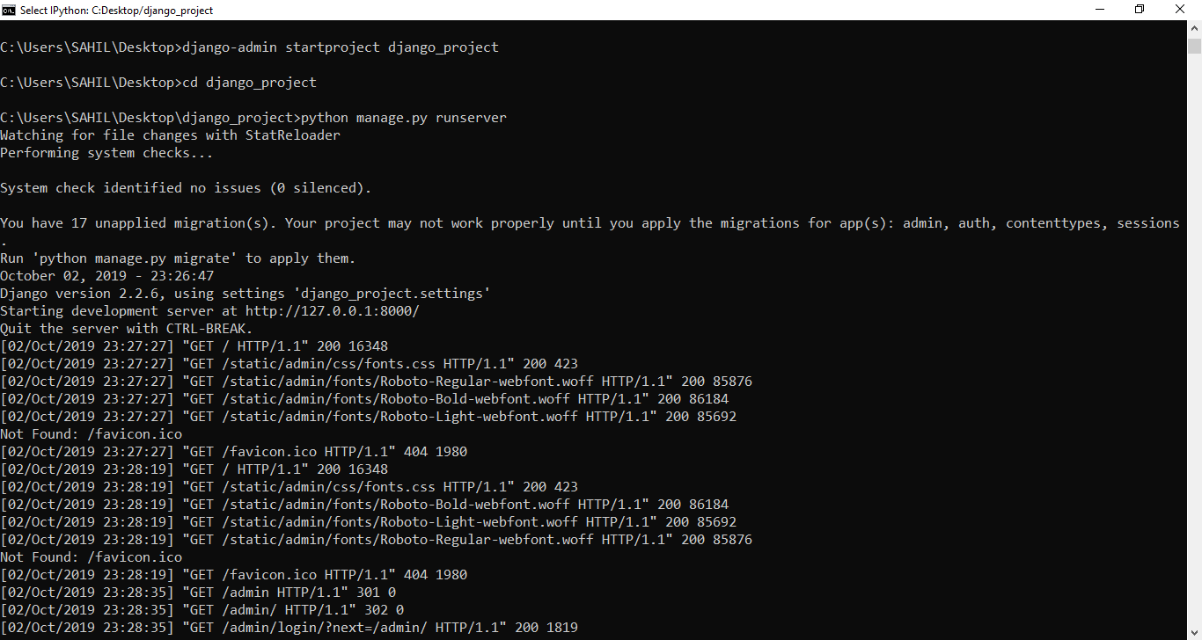
Command to create a project in Django
django-admin startproject projectname is used to create a project with django
python manage.py runserver is user to run the website
python manage.py startapp BLOG is used to create an app name BLOG

Slide 8
Necessary files in a django web app
manage.py file allows us to run command line commands
django_project directory:-
__init__.py tells that it is a python package
settings.py is used to change different settings and configurations. We have a secret key, installed app section, database section and some useful settings in it.
urls.py is used to set up the mapping that where we want to send the user
wsgi.py is used to make web server and web application communicate

Slide 9
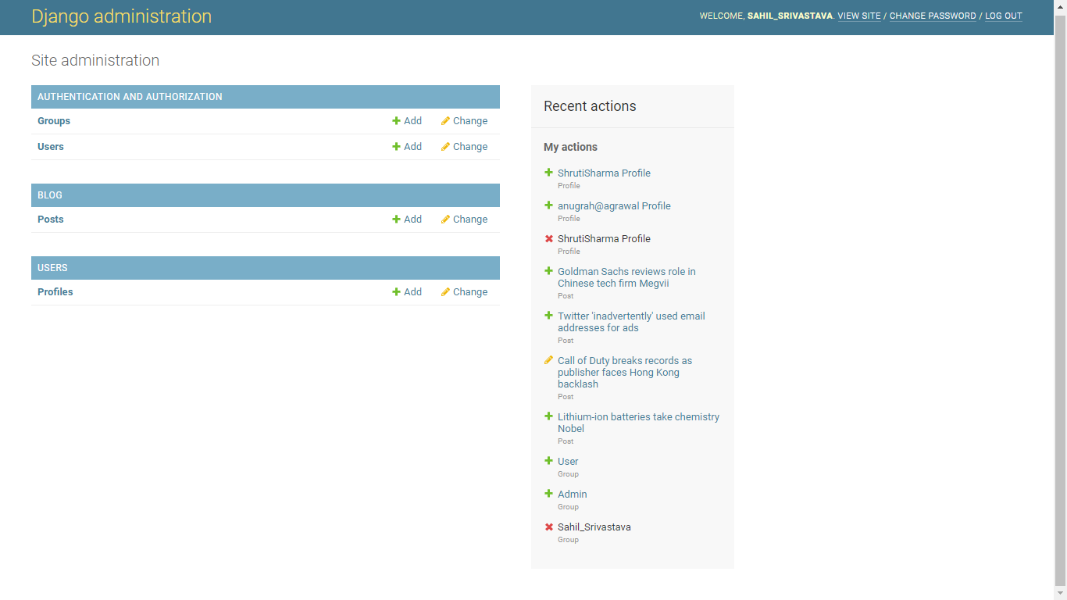
Blog Admin Page

Slide 10
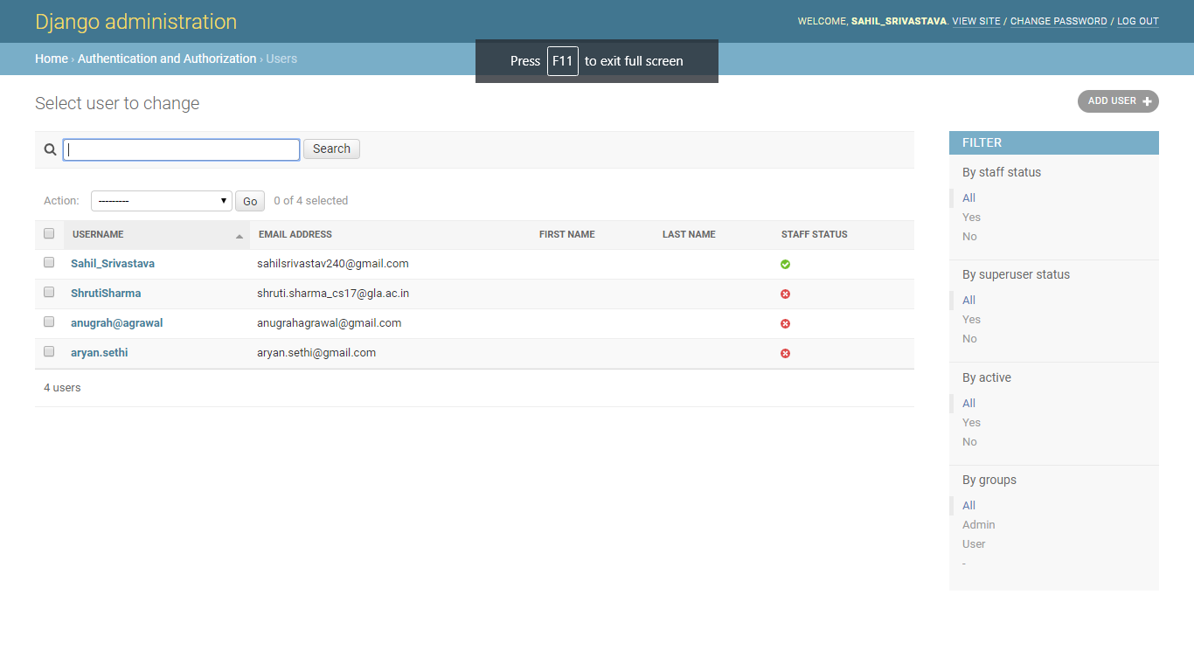

Slide 11
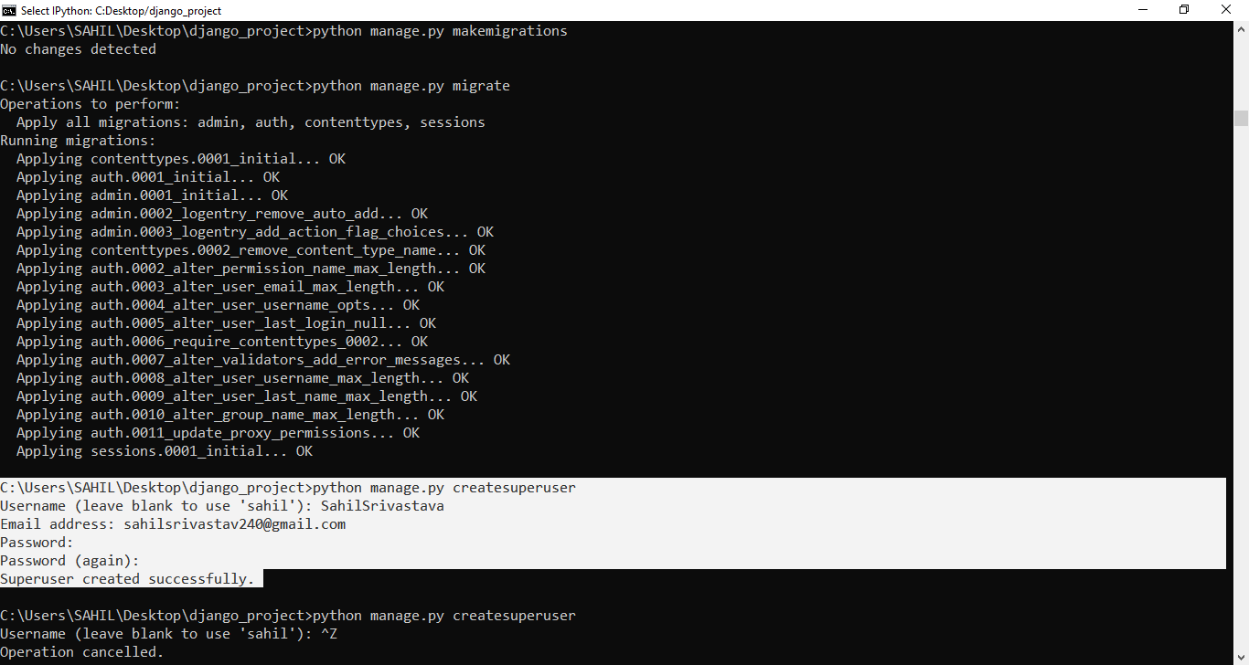
Command to create a super user/admin
python manage.py createsuperuser

Slide 12
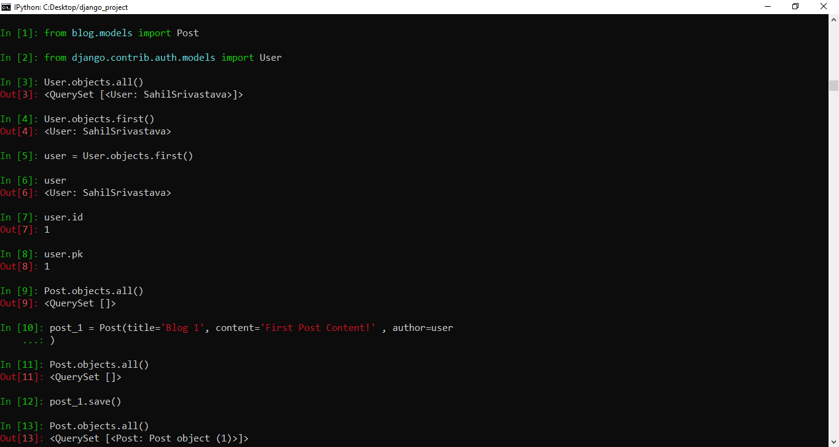
Database and Migrations

Slide 13
Commands for database execution
python manage.py migration used to migrate the databse
User.objects.all() shows the number of users that are registered
User.objects.first() show the first user that is registered
User.objects.last() show the last user that is registered
user=User.objects.first()
user.id() attribute gives the primary key of the user
Post_objects.all() gives the total posts that are stored in the database
Post_name.save() is used to save the post in the database

Slide 14
Zero Level DFD of BLOG
Basic overview of the whole online Blog system where processes being analyzed or modeled
Designed to be an at-a-glance view of Comment, Technology, Blog and Web page showing the system as a single high-level-process
Elaborated the high level proces of Online Blogging
Shows the relationships of Comment, Technology, Blog and Web Page to external entities of Blog, Blog Category and Create Blog

Slide 15
Technology
Management
Blog Management
Comment
Management
Online Blogging System
Create Blog Management
System User
Management
Login Management

Slide 16
Managing all the Blog Managing all the Blog Category Managing all the Create Blog Managing all the Blog Type Managing all the Comment Managing all the Technology Blog Managing all the Web Page
High Level Entities and process flow of online blogging system:

Slide 17
First Level DFD of BLOG
Shows how the system is divided into sub-systems, each of which deals with one or more of the data flows to or from an external agent, and which together provide all of the functionality of the Online Blogging System as a whole.
Identifies internal data stores of Web Page, Technology Blog, Comment, Blog Type, Create Blog that must be present in order for the online blogging system to do its job
Shows the flow of data between various parts of Blog, Create Blog, Technology Blog, Web Page
Provides a more detailed breakout of pieces

Slide 18
Blog Management
Generate Blog Report
Generate Technology Blog Report
Comment Management
Online Blogging System
Technology Blog Management
Generate Comment Report
Web Page Management
Generate Web Page Report
System User Management
Check User Login Details
Login Management
Generate System User Report

Slide 19
Main entities and output of First Level DFD
Processing Blog records and generate report of all Blogs
Processing Blog Category records and generate report of all Blog Category
Processing Create Blog records and generate report of all Create Blog
Processing Blog Type records and generate report of all Blog Type
Processing Comment records and generate report of all Comments
Processing Technology Blog records and generate report of all Technology Blog
Processing Web Page records and generate report of all Web Pages

Slide 20
Second Level DFD of BLOG
One step deeper into parts of level 1 of online blogging system
Contains more details of Web Pages, Technology Blog, Comment, Blog Type, Create Blog, Blog Category and Blog
Requires more functionality of online blogging to dive into the Second Level DFD

Slide 21
Manage Blog Details
Login to System
Check Roles of Access
Admin
Manage Create Blog Details
Forgot Password
Manage Modules
Manage Web Page Details
Check Credent-ials
Manage Comment Details
Send email to user
Manage Technology Blog Details
Manage Publish Details
Manage System Admins
Manage Roles of Users
Manage User Permission
Manage Report

Slide 22
Low Level Functionalities of Online Blogging System
Admin logins to the system and manage all the functionalities of Online Blogging System
Admin can add, edit, delete and view the records of Blog, Create Blog, Comment, Web Page
Admin can manage all the details of Blog Category, Blog Type, Technology Blog
Admin can also generate reports of Blog, Blog Category, Create Blog, Blog Type, Comment, Technology Blog
Admin can search the details of Blog Category, Comment, Technology Blog
Admin can apply different level of filters on report of Blog, Blog Type, Comment
Admin can track the detailed information of Blog Category, Create Blog, Blog Type, Comment

Slide 23
Entity Relationship (ER)
Blogging System entity and their attributes:
Blog Entity:-
blog_id, blog_user_id, blog_title, blog_type, blog_content, blog_description
Blog Category Entity:-
blog_category_id, blog_category, blog_category_title, blog_category_type, blog_category_content, blog_category_description
Create Blog Entity:-
blog_id, blog_user_id, blog_title, blog_type, blog_content, blog_description
Comment Entity:-
comment_id, comment_user_id, comment_type, comment_title, comment_description
Blog Type Entity:-
blog_type_id, blog_type_name, blog_type_description

Slide 24
Description of Database
The details of Blog is store into the Blog tables respective with all tables.
Each entity(Technology Blog, Create Blog, Comment, Blog Category, Blog) contains primary key and unique keys
The entity Create Blog, Comment has binded with Blog, Blog Category entities with foreign key
There is one-to-one and one one-to-many relationships available between Comment, Blog Type, Technology Blog, Blog
All the entities Blog, Comment, Create Blog, Technology, Blog are normalized and reduce duplicacy of records

Slide 25
ER DIAGRAM

Slide 26
#user_id
Login_id
Login_roleid
Login_username
User_password
User_name
#role_id
Role_name
User_mobile
Role_desc
Per_roleid
Login
User
Roles
#per_id
User_mail
perr_module
User_addil
has
Permission
Per_name
Blog_type
#blog_id
Blog_title
Manage
Blog_desc
Bc_content
blog
Blog_content
Comm_user_id
has
Blog category
Bc_desc
Blog_user_id
comment
#comm_id
#bc_id
Bc_type
Bc_title
Com_desc
Blog type
Comm_title
#bt_id
Comm_type
Bt_name
Bt_desc

Slide 27
USE CASE DIAGRAM
Graphic depiction of the interactions among the elements of the Blogging System
Represents the methodology used in system to identify, clarify, and organize system requirements of Blogging System
Main actors are:-
Super Admin, System User, Blogger, Anonymous Users who perform the different type of use cases such as Manage Blog, Manage Blog Category, Manage Create Blog, Manage Blog Type, Manage Comment, Manage Technology, Manage Web Page

Slide 28
Manage Users and Full Application
Manage Blog
Search Blogs
Super Admin
Manage Blog Category
View Comments
Login and Logout from System
Update My Profile
Blogger
Change Account Password
Manage Create Blog
Add Blog Posts
System User
Manage Blog Type
Create Category
Manage Technology Blog
Make Comments

Slide 29
Sequence Diagram
UML sequence diagram of Blogging System which shows the interaction between the objects of Blog, Web Page, Blog Type, Category, Comment.
Demonstrates how the login page works in a blogging system
Instance of class objects invloved in this UML Sequence Diagram of Blogging System are as follows:-
Blog Object
Web Page Object
Blog Type Object
Category Object
Comment Object

Slide 30
Admin
Login Page
Forgot Password
Verification
Database
Authenticate Page
Forgot Password
Check Authentication For Access
Login to Page
Provide Authorization For Access
Check Login Details
Valid Login Details
Allow users to access the internal pages on bassis of user tokens and session
Check Security Questions And Answers
Create session in and store in database
Send email to set user to reset password
Invalid Log in Details
Allow users to access the page
Logout from application
Destroy Sessions and tokens from database
Login Successfully

Slide 31
This is the login sequence diagram of a blogging system, where admin will be able to login into their account using their credentials.
After login, user can manage all the operations on Blog Type, Blog, Web Page, Comment, Category.
All the pages such as Web Page, Comment, Category are secure and user can access these pages after login.
The various objects in the Comment, Blog Type, Blog, Web Page and Category Page- interact over the course of the sequence , and user will not be able to access this page without verifying their identity.

Slide 32
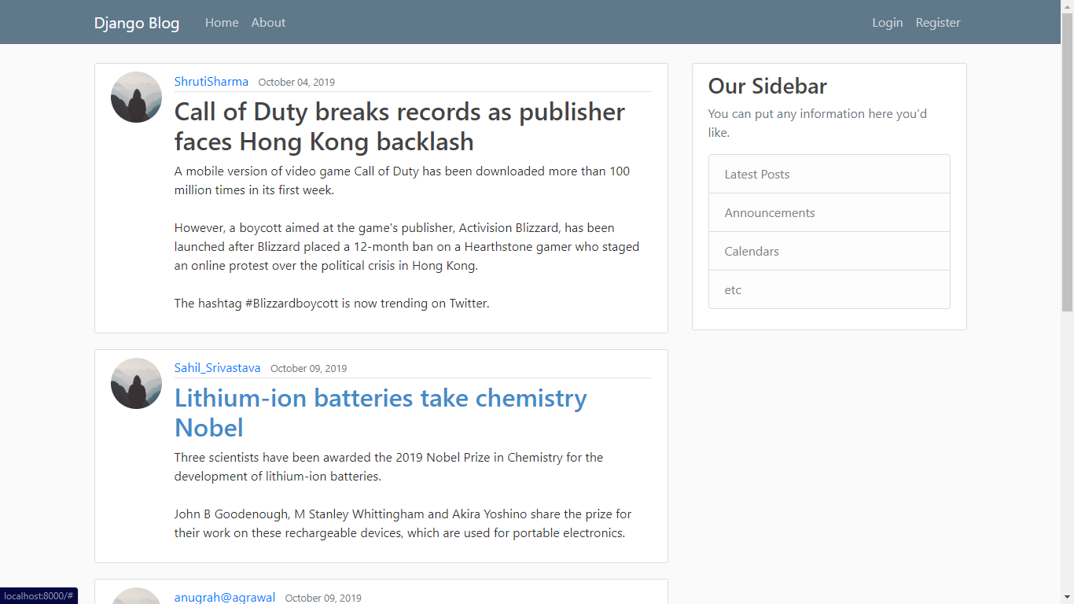
Blog Home Page

Slide 33
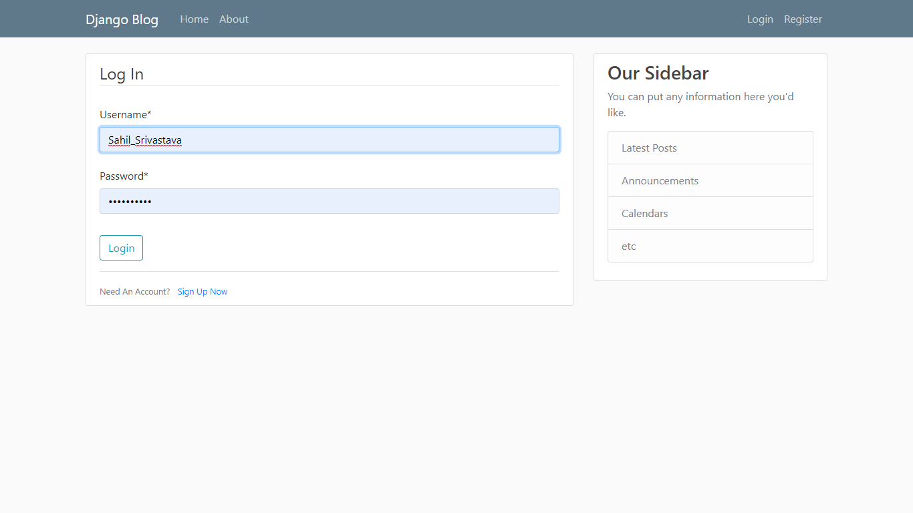
Blog Login Page

Slide 34
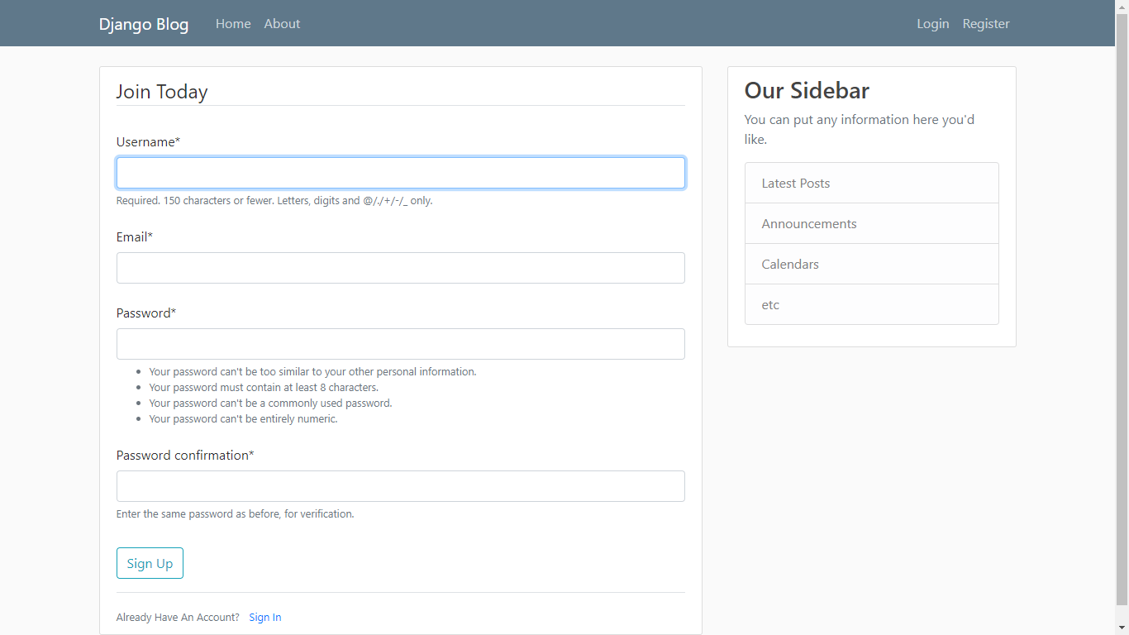
Blog Registration Page

Slide 35
Docker is used to build, ship, and run distributed applications. You can configure your service instances to run in Docker containers.
Introduction to Docker
Apps
A Docker container allows an application to be packed together with its dependencies into a portable virtual package that can run with multi-platform support, isolation, and resource limits applied.
Cloud
DevOps

Slide 36
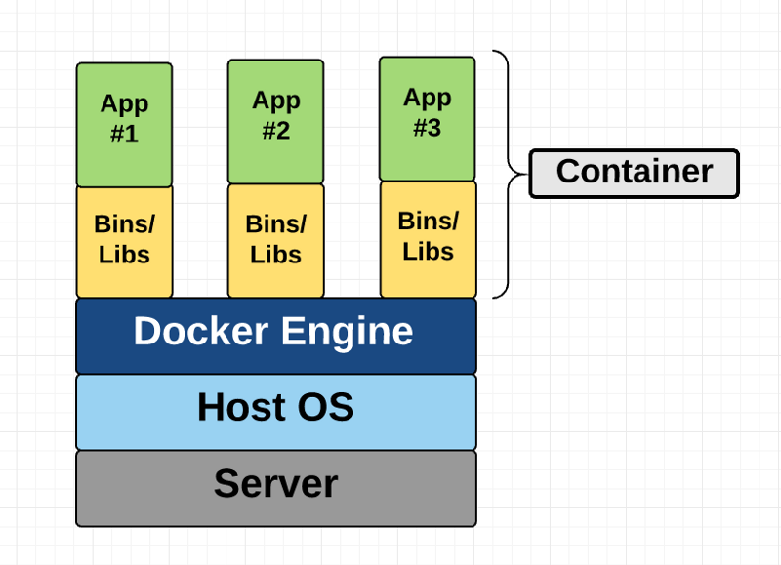
What is a container?
A container is a standard unit of software that packages up code and all its dependencies so the application runs quickly and reliably from one computing environment to another.
Standardized packaging for software and dependencies
Isolate apps from each other
Share the same OS kernel
Works with all major Linux and Windows Server

Slide 37
Docker Basics
Image
The basis of a Docker container. The content at rest.
Container
The image when it is ‘running.’ The standard unit for app service
Engine
The software that executes commands for containers. Networking and volumes are part of Engine. Can be clustered together.
Registry
Stores, distributes and manages Docker images
Control Plane
Management plane for container and cluster orchestration

Slide 38
Key Benefits of Docker Containers
Speed
No OS to boot i.e applications online in seconds
Portability
Less dependencies between process layers i.e aility to move infrastructure
Efficiency
Less overhead VM's
Improved VM's density

Slide 39
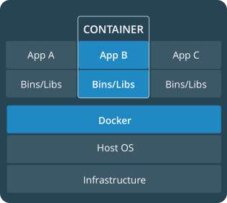
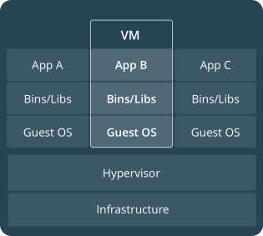
Comparing Containers and VMs
VMs are an infrastructure level construct to turn one machine into many servers
Containers are an app level construct

